Slide 1
Lingo game
Ali Ibryamov, Ilija Filipovic, Aleksandar Manov, Qijin Bai

Slide 2

HTML
In this project, HTML is used to:
Create the title of the game
Create the game board container
Link CSS and JavaScript files
Example:
This creates the area where the game grid is displayed

Slide 3
Elements
Building blocks of the webpage, for example:
<div> - container for grouping content
<button> - clickable action
<span> - small inline content
<input> - user text input
Each letter box in the game is a <div> element created using JavaScript.

Slide 4



Connection JavaScript + CSS with HTML
CSS is linked in the HTML <head>:
Mainly used for color feedback
and size/alignment of boxes.
JavaScript connects using:
Changes and modifies the
website dynamically.

Slide 5
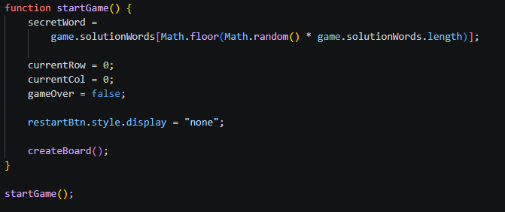
JavaScript functions
Functions are segments of reusable code that perform specific tasks. In this case, they control the game logic.
startGame() – sets up a new game
evaluateGuess() – checks if
the guess is correct
createBoard() builds the grid
getCell() – finds a specific tile

Slide 6
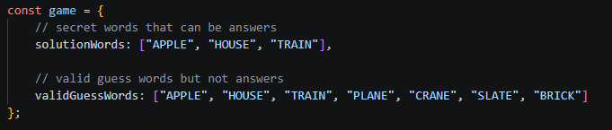
JavaScript objects
An object is a structured collection of related data stored in key-value pairs.
game is an object
It acts as a container, grouping multiple things and allowing easy access to individual pieces, for example game.solutionWords

Slide 7
Differences between elements and objects
JavaScript Object
HTML Element
Stores data and logic
Exists in JavaScript memory
Is more of a backstage worker, for example: word lists
Displays content
Exists on the webpage
Visible UI and such rather than complex things.

Slide 8
Code
ALT + TAB x 2

Slide 9
Thank you
for listening

